Slide 1
Digital Logic & Digital Systems
4004CEM
Computer Architecture & Networks

Slide 2
Introduction to Logic Circuit Design
Truth tables
Boolean expressions
Symbols of logic operators
Basic logic gates
Proof using truth tables
Logic circuits and transmission formulae, equivalent circuits
Standard results
NAND and NOR gates
XOR and XNOR gates

Slide 6
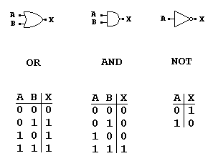

Slide 7
A I
A B
I I
I >O
O>I

Slide 8
The Inverter
A
X
The inverter performs the Boolean NOT operation. When the input is LOW, the output is HIGH; when the input is HIGH, the output is LOW.
LOW (0) HIGH (1)
HIGH (1) LOW(0)
The NOT operation (complement) is shown with an overbar. Thus, the Boolean expression for an inverter is X = A.

Slide 9
The Inverter
A
X
Example waveforms:
A
X
A group of inverters can be used to form the 1’s complement of a binary number:
Binary number
1 0 0 0 1 1 0 1
0 1 1 1 0 0 1 0
1’s complement

Slide 10
The AND Gate
A
X
A
B
X
B
The AND gate produces a HIGH output when all inputs are HIGH; otherwise, the output is LOW. For a 2-input gate, the truth table is
0 0
0 1
1 0
1 1
0
0
0
1
The AND operation is usually shown with a dot between the variables but it may be implied (no dot). Thus, the AND operation is written as X = A.B or X = AB.

Slide 11
The AND Gate
A
X
A
B
X
Example waveforms:
B
A
I
I
I
I
O
O
I
I
O
O
B
O
I
I
O
O
I
I
I
O
I
O
I
I
O
O
O
O
O
X
I
I
The AND operation is used in computer programming as a selective mask. If you want to retain certain bits of a binary number but reset the other bits to 0, you could set a mask with 1’s in the position of the retained bits.
Example
If the binary number 10100011 is ANDed with the mask 00001111, what is the result?
00000011

Slide 12
The OR Gate
A
X
A
X
B
B
The OR gate produces a HIGH output if any input is HIGH; if all inputs are LOW, the output is LOW. For a 2-input gate, the truth table is
0 0
0 1
1 0
1 1
0
1
1
1
The OR operation is shown with a plus sign (+) between the variables. Thus, the OR operation is written as X = A + B.

Slide 13
The OR Gate
A
X
A
X
B
B
Example waveforms:
A
B
X
The OR operation can be used in computer programming to set certain bits of a binary number to 1.
Example
ASCII letters have a 1 in the bit 5 position for lower case letters and a 0 in this position for capitals. (Bit positions are numbered from right to left starting with 0.) What will be the result if you OR an ASCII letter with the 8-bit mask 00100000?
Solution
The resulting letter will be lower case.

Slide 14
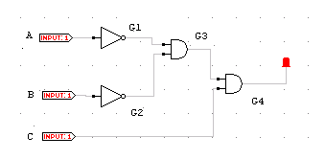
A B C G1 G2 G3 G4
0 0 0 1 1 1 0
0 0 1 1 1 1 1
0 1 0 1 0 0 0
0 1 1 1 0 0 0
1 0 0 0 1 0 0
1 0 1 0 1 0 0
1 1 0 0 0 0 0
1 1 1 0 0 0 0

Slide 15
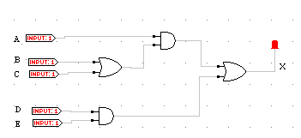

Slide 25
The NAND Gate
A
X
A
X
B
B
The NAND gate produces a LOW output when all inputs are HIGH; otherwise, the output is HIGH. For a 2-input gate, the truth table is
0 0
0 1
1 0
1 1
1
1
1
0
The NAND operation is shown with a dot between the variables and an overbar covering them. Thus, the NAND operation is written as X = A .B (Alternatively, X = AB.)

Slide 26

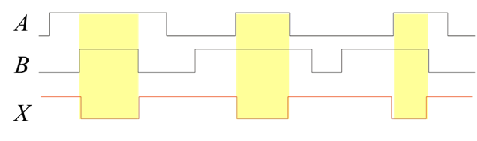
The NAND Gate
A
A
X
B
X
B
Example waveforms:

Slide 27
The NOR Gate
A
X
A
X
B
B
The NOR gate produces a LOW output if any input is HIGH; if all inputs are HIGH, the output is LOW. For a 2-input gate, the truth table is
0 0
0 1
1 0
1 1
1
0
0
0
The NOR operation is shown with a plus sign (+) between the variables and an overbar covering them. Thus, the NOR operation is written as X = A + B.

Slide 28
The NOR Gate
A
X
A
X
B
B
Example waveforms:
A
B
X
The NOR operation will produce a LOW if any input is HIGH.
Example
When is the LED is ON for the circuit shown?
Solution

Slide 29
The NOR Gate
A
X
A
X
B
B
Example waveforms:
A
B
X
The NOR operation will produce a LOW if any input is HIGH.
Example
When is the LED is ON for the circuit shown?
Solution
The LED will be on when none of the four inputs are HIGH.

Slide 30


Slide 31
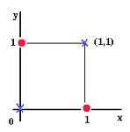
A
X
A
X
The XOR Gate
B
B
The XOR gate produces a HIGH output only when both inputs are at opposite logic levels. The truth table is
0 0
0 1
1 0
1 1
0
1
1
0
The XOR operation is written as X = AB + AB. Alternatively, it can be written with a circled plus sign between the variables as X = A + B.

Slide 32
A
X
A
X
The XOR Gate
B
B
Example waveforms:
A
B
X
Notice that the XOR gate will produce a HIGH only when exactly one input is HIGH.
Question
If the A and B waveforms are both inverted for the above waveforms, how is the output affected?

Slide 33
A
X
A
X
The XOR Gate
B
B
Example waveforms:
A
B
X
Notice that the XOR gate will produce a HIGH only when exactly one input is HIGH.
Question
If the A and B waveforms are both inverted for the above waveforms, how is the output affected?
There is no change in the output.

Slide 34

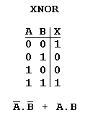

Slide 35
The XNOR Gate
A
A
B
B
The XNOR gate produces a HIGH output only when both inputs are at the same logic level. The truth table is
0 0
0 1
1 0
1 1
1
0
0
1
The XNOR operation shown as X = AB + AB. Alternatively, the XNOR operation can be shown with a circled dot between the variables. Thus, it can be shown as X = A . B.

Slide 36
The XNOR Gate
A
A
B
B
Example waveforms:
A
B
X
Notice that the XNOR gate will produce a HIGH when both inputs are the same. This makes it useful for comparison functions.
Question
If the A waveform is inverted but B remains the same, how is the output affected?

Slide 37
The XNOR Gate
A
A
B
B
Example waveforms:
A
B
X
Notice that the XNOR gate will produce a HIGH when both inputs are the same. This makes it useful for comparison functions.
Question
If the A waveform is inverted but B remains the same, how is the output affected?
The output will be inverted.

Slide 38
END

